Slide 1
File Management

Slide 2
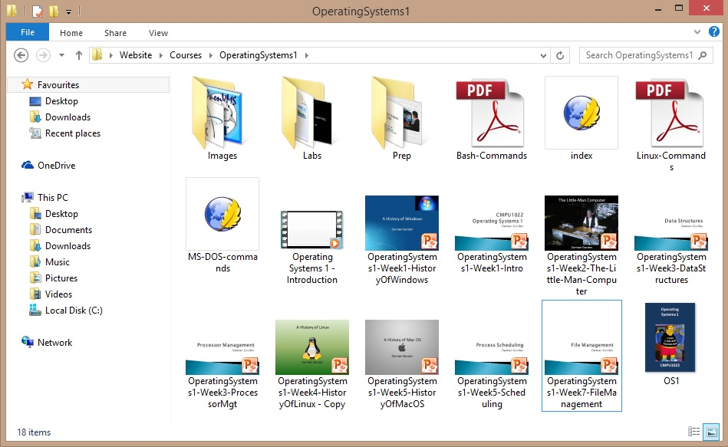
File Management

Slide 3
BELIEVE IT OR NOT!
From the computer’s point of view, there is no such thing as a file.
It is only because the operating system is creating the illusion of a file that they exist
From the computer’s point of view, there is only blocks of memory, either allocated or unallocated.

Slide 4
File Management
The File Manager (or File Management System) is the manager in the Operating System that creates the illusion that there are files and folders being stored in computer memory.
Operating System
Files and Folders
Hardware
Memory Locations

Slide 5
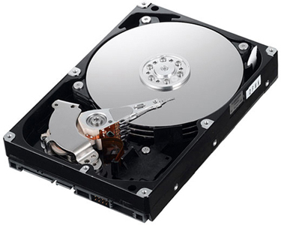
Hard Disk

Slide 6
Hard Disk
v
v
v

Slide 7
Hard Disk
Track
v
v
v

Slide 8
Hard Disk
Track
v
v
v
Sector

Slide 9
Hard Disk
Track
Block
v
v
v
Sector

Slide 10
v
v
v

Slide 11
Unallocated Memory

Slide 12
Allocated Memory

Slide 13
File Management
The File Manager
Keeps track of where files are stored
Determines how the files are stored
Follows operating system file allocation policies
Uses available storage space efficiently for files
Creates a record/log of all file usage
Allocates a file to a user if is free, and if they are permitted access to it.
De-allocates file when user finished with it.

Slide 14
File Management
The file manager ALLOCATES a file by reading it from the hard disk and loading it into memory while updating its record of who is using what file.
The file manager DEALLOCATES a file by updating the file tables and rewriting the file (if changed) to the hard disk. Any processes waiting to access the file will be notified.

Slide 15
File Management
Some definitions:
A FIELD is a collection of bytes that can be identified by a user and has a type and size.
A RECORD is a collection of related FIELDS.
A FILE is a collection of records.
A DIRECTORY (or FOLDER) is a special type of file that which has lists of files and their attributes.

Slide 16
File Management
Typical things you can do with a file are:
CREATE
OPEN
DELETE
RENAME
COPY
etc.

Slide 17
File Management
The name of a file is usually in two parts:

Slide 18
File Management
The name of a file is usually in two parts:
MakeABackup.sh

Slide 19
File Management
The name of a file is usually in two parts:
MakeABackup.sh
Filename

Slide 20
File Management
The name of a file is usually in two parts:
MakeABackup.sh
Filename
Extension

Slide 21
File Management
.mp4 | Mpeg video
.sh | Shell script
.doc(x) | Microsoft Word for Windows
.gif | Graphics Interchange Format
.md | Markdown file
.html | Hypertext Markup Language (common web page file)
.jpg | JPEG graphic file
.pdf | Adobe Portable Document Format File
. ppt(x) | Power Point file
.xls | Excel file

Slide 22
File Management
The full filename includes path information:
/home/users/davidb/MakeABackup.sh
Filename
Extension

Slide 23
File Management
The full filename includes path information:
/home/users/davidb/MakeABackup.sh
Path
Filename
Extension

Slide 24
File Management
The full filename includes path information:
/home/users/davidb/MakeABackup.sh
Path
Filename
Extension
Absolute filename

Slide 25
File Management
If I am in the following folder:
/home/users/davidb/tmp
Then the address of the file is:
../MakeABackup.sh
Relative filename

Slide 26
Physical Storage Allocation
The Operating System store files as records in memory, where many records make up a single file.
There are three main ways a file is physically stored in memory:
Contiguous Storage
Non-contiguous Storage
Indexed Storage

Slide 27

Contiguous Storage
Contiguous Storage means that records of a file are stored one after another.
It is a very simple policy to implement, and once you have found the start of the file, it’s very easy to find the rest of it.
For example, if a user process needs some x bytes of contiguous memory, then all the x bytes will reside in one place in the memory that is defined by a range of memory addresses: 0x0000 to 0x00FF

Slide 28
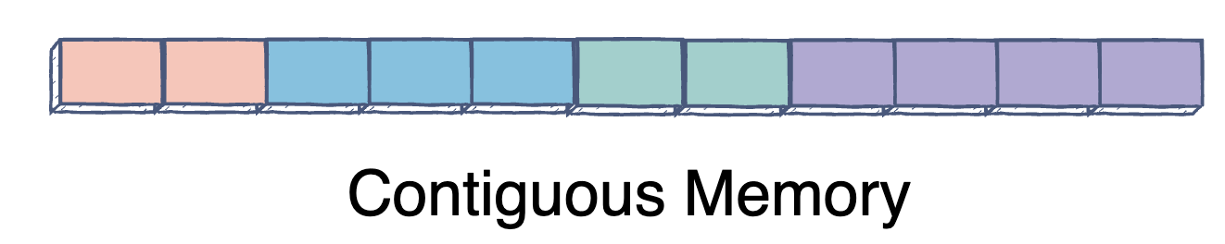
Contiguous Storage

Slide 29
Contiguous Storage
New file:
a | b | c | d | e | f | g | h

Slide 30
Contiguous Storage
a | b | c | d | e | f | g | h
Does it fit here?

Slide 31
Contiguous Storage
a | b | c | d | e | f | g | h
Does it fit here?
NO!

Slide 32
Contiguous Storage
a | b | c | d | e | f | g | h

Slide 33
Contiguous Storage
a | b | c | d | e | f | g | h

Slide 34
Contiguous Storage
a | b | c | d | e | f | g | h
Does it fit here?

Slide 35
Contiguous Storage
a | b | c | d | e | f | g | h
Does it fit here?
NO!

Slide 36
Contiguous Storage
a | b | c | d | e | f | g | h

Slide 37
Contiguous Storage
a | b | c | d | e | f | g | h
Does it fit here?

Slide 38
Contiguous Storage
a | b | c | d | e | f | g | h
Does it fit here?
YES!

Slide 39
Contiguous Storage
a | b | c | d | e | f | g | h
Does it fit here?
YES!

Slide 40
Contiguous Storage
a | b | c | d | e | f | g | h
Does it fit here?
YES!

Slide 41
Contiguous Storage
The problem with is that if you have expanded the file, you either need to have free space allocated at the end or copy the whole file to a different location on the disk that has enough space.

Slide 42
Non-contiguous Storage
Non-contiguous Storage means that records of a file are stored wherever there is free space.
The file manager will try to put as much of it together as possible, but there will be other part spread out over the disk.
These extra bits are sometimes called extents and these are linked together with pointers.
This means there is no easy way to determine the exact location of a record in a file.

Slide 43
Non-contiguous Storage
New file:
a | b | c | d | e | f | g | h

Slide 44
Non-contiguous Storage
a | b | c | d | e | f | g | h
Does it fit here?

Slide 45
Non-contiguous Storage
a | b | c | d | e | f | g | h
Does it fit here?
Who cares, this is where it is going

Slide 46
Non-contiguous Storage
a | b | c | d | e | f | g | h

Slide 47
Non-contiguous Storage
a | b | c | d | e | f | g | h

Slide 48
Non-contiguous Storage
a | b | c | d
e | f | g | h

Slide 49
Non-contiguous Storage
a | b | c | d
e | f | g | h
Extent

Slide 50
Non-contiguous Storage
a | b | c | d
e | f | g | h
Extent

Slide 51
Non-contiguous Storage
a | b | c | d
e | f | g | h
Extent

Slide 52
Indexed Storage
Indexed Storage means that as well as the records in the file, a special block known as an index block is created, with pointers to each individual file.
Each file has it’s own index block. All the pointers are put together in this index block.
This means that we can access all the locations of blocks in one index file.
It overcomes the problem of external fragmentation in non-contiguous storage
It supports both sequential and direct access to records.

Slide 53
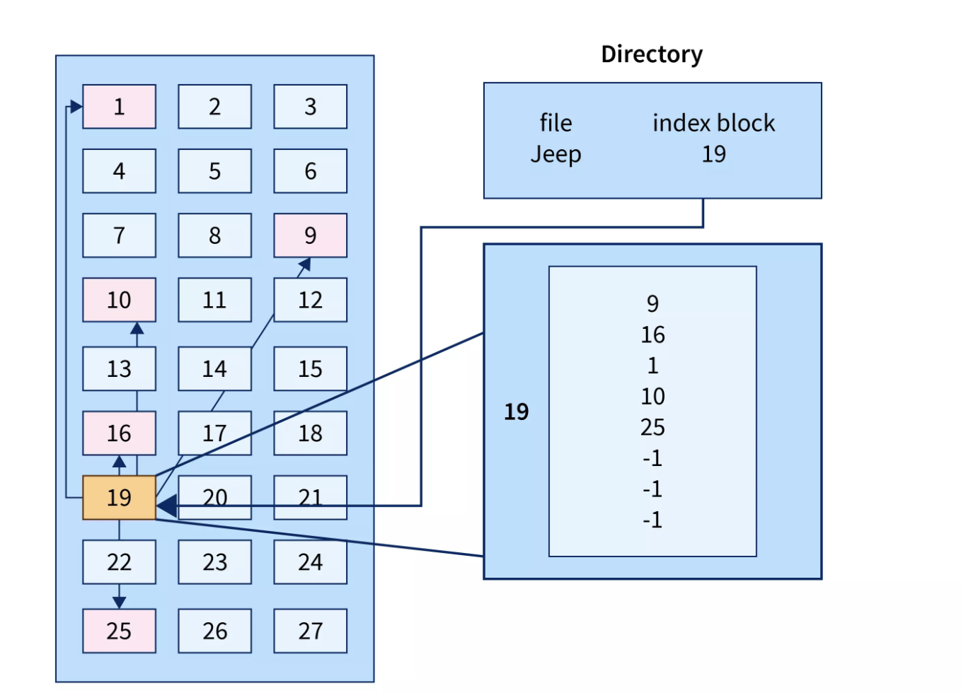
Indexed Storage
As shown in the diagram block 19 is the index block which contains all the addresses of the file named text1.
In order, the first storage block is 9, followed by 16, 1, then 10, and 25. The negative number -1 here denotes the empty index block list as the file text1 is still too small to fill more blocks.

Slide 54
Indexed Storage
e | f | g | h
 |  |  |  |  |  |  |  |  |  |  |  |  |  |  | v | w | x | y | z
a | b | c | d

Slide 55
Indexed Storage
e | f | g | h
 |  |  |  |  |  |  |  |  |  |  |  |  |  |  | v | w | x | y | z
a | b | c | d
File 1:
abcdefgh
File 2:
vwxyz

Slide 56
Indexed Storage
File 1
e | f | g | h
 |  |  |  |  |  |  |  |  |  |  |  |  |  |  | v | w | x | y | z
a | b | c | d
File 1:
abcdefgh
File 2:
vwxyz

Slide 57
Indexed Storage
File 1
File 2
e | f | g | h
 |  |  |  |  |  |  |  |  |  |  |  |  |  |  | v | w | x | y | z
a | b | c | d
File 1:
abcdefgh
File 2:
vwxyz

Slide 58
Indexed Storage
File 1
File 2
e | f | g | h
 |  |  |  |  |  |  |  |  |  |  |  |  |  |  | v | w | x | y | z
a | b | c | d
File 1:
abcdefgh
Without an INDEX BLOCK, how do I find file 2?
File 2:
vwxyz

Slide 59
Indexed Storage
File 1
File 2
e | f | g | h
 |  |  |  |  |  |  |  |  |  |  |  |  |  |  | v | w | x | y | z
a | b | c | d
File 1:
abcdefgh
Without an INDEX BLOCK, how do I find file 2?
File 2:
vwxyz
We do a
sequential search.

Slide 60
Indexed Storage
File 1
File 2
e | f | g | h
 |  |  |  |  |  |  |  |  |  |  |  |  |  |  | v | w | x | y | z
a | b | c | d
Is this file 2?

Slide 61
Indexed Storage
File 1
File 2
e | f | g | h
 |  |  |  |  |  |  |  |  |  |  |  |  |  |  | v | w | x | y | z
a | b | c | d
NO!
Is this file 2?

Slide 62
Indexed Storage
File 1
File 2
e | f | g | h
 |  |  |  |  |  |  |  |  |  |  |  |  |  |  | v | w | x | y | z
a | b | c | d
Is this file 2?

Slide 63
Indexed Storage
File 1
File 2
e | f | g | h
 |  |  |  |  |  |  |  |  |  |  |  |  |  |  | v | w | x | y | z
a | b | c | d
NO!
Is this file 2?

Slide 64
Indexed Storage
File 1
File 2
e | f | g | h
 |  |  |  |  |  |  |  |  |  |  |  |  |  |  | v | w | x | y | z
a | b | c | d
Is this file 2?

Slide 65
Indexed Storage
File 1
File 2
e | f | g | h
 |  |  |  |  |  |  |  |  |  |  |  |  |  |  | v | w | x | y | z
a | b | c | d
NO!
Is this file 2?

Slide 66
Indexed Storage
File 1
File 2
e | f | g | h
 |  |  |  |  |  |  |  |  |  |  |  |  |  |  | v | w | x | y | z
a | b | c | d
NO!
Is this file 2?

Slide 67
Indexed Storage
File 1
File 2
e | f | g | h
 |  |  |  |  |  |  |  |  |  |  |  |  |  |  | v | w | x | y | z
a | b | c | d
NO!
Is this file 2?

Slide 68
Indexed Storage
File 1
File 2
e | f | g | h
 |  |  |  |  |  |  |  |  |  |  |  |  |  |  | v | w | x | y | z
a | b | c | d
NO!
Is this file 2?

Slide 69
Indexed Storage
File 1
File 2
e | f | g | h
 |  |  |  |  |  |  |  |  |  |  |  |  |  |  | v | w | x | y | z
a | b | c | d
NO!
Is this file 2?

Slide 70
Indexed Storage
File 1
File 2
e | f | g | h
 |  |  |  |  |  |  |  |  |  |  |  |  |  |  | v | w | x | y | z
a | b | c | d
NO!
Is this file 2?

Slide 71
Indexed Storage
File 1
File 2
e | f | g | h
 |  |  |  |  |  |  |  |  |  |  |  |  |  |  | v | w | x | y | z
a | b | c | d
NO!
Is this file 2?

Slide 72
Indexed Storage
File 1
File 2
e | f | g | h
 |  |  |  |  |  |  |  |  |  |  |  |  |  |  | v | w | x | y | z
a | b | c | d
NO!
Is this file 2?

Slide 73
Indexed Storage
File 1
File 2
e | f | g | h
 |  |  |  |  |  |  |  |  |  |  |  |  |  |  | v | w | x | y | z
a | b | c | d
NO!
Is this file 2?

Slide 74
Indexed Storage
File 1
File 2
e | f | g | h
 |  |  |  |  |  |  |  |  |  |  |  |  |  |  | v | w | x | y | z
a | b | c | d
NO!
Is this file 2?

Slide 75
Indexed Storage
File 1
File 2
e | f | g | h
 |  |  |  |  |  |  |  |  |  |  |  |  |  |  | v | w | x | y | z
a | b | c | d
NO!
Is this file 2?

Slide 76
Indexed Storage
File 1
File 2
e | f | g | h
 |  |  |  |  |  |  |  |  |  |  |  |  |  |  | v | w | x | y | z
a | b | c | d
NO!
Is this file 2?

Slide 77
Indexed Storage
File 1
File 2
e | f | g | h
 |  |  |  |  |  |  |  |  |  |  |  |  |  |  | v | w | x | y | z
a | b | c | d
NO!
Is this file 2?

Slide 78
Indexed Storage
File 1
File 2
e | f | g | h
 |  |  |  |  |  |  |  |  |  |  |  |  |  |  | v | w | x | y | z
a | b | c | d
Is this file 2?

Slide 79
Indexed Storage
File 1
File 2
e | f | g | h
 |  |  |  |  |  |  |  |  |  |  |  |  |  |  | v | w | x | y | z
a | b | c | d
YES!
Is this file 2?

Slide 80
Indexed Storage
File 1
File 2
e | f | g | h
 |  |  |  |  |  |  |  |  |  |  |  |  |  |  | v | w | x | y | z
a | b | c | d
File 1:
abcdefgh
File 2:
vwxyz

Slide 81
Indexed Storage
File 1
File 2
e | f | g | h
 |  |  |  |  |  |  |  |  |  |  |  |  |  |  | v | w | x | y | z
a | b | c | d
File 1:
abcdefgh
So how does it work with an INDEX BLOCK?
File 2:
vwxyz

Slide 82
Indexed Storage
File 1
File 2
e | f | g | h
 |  |  |  |  |  |  |  |  |  |  |  |  |  |  | v | w | x | y | z
a | b | c | d
INDEX BLOCK:
File 1:
abcdefgh
File | Address | Size | Next
File 1 | 1 | 4 | 9
File 1 | 9 | 4 | -
File 2 | 15 | 5 | -
File 2:
vwxyz

Slide 83
Indexed Storage
File 1
File 2
e | f | g | h
 |  |  |  |  |  |  |  |  |  |  |  |  |  |  | v | w | x | y | z
a | b | c | d
INDEX BLOCK:
File | Address | Size | Next
File 1 | 1 | 4 | 9
File 1 | 9 | 4 | -
File 2 | 15 | 5 | -

Slide 84
Indexed Storage
File 1
File 2
e | f | g | h
 |  |  |  |  |  |  |  |  |  |  |  |  |  |  | v | w | x | y | z
a | b | c | d
INDEX BLOCK:
File | Address | Size | Next
File 1 | 1 | 4 | 9
File 1 | 9 | 4 | -
File 2 | 15 | 5 | -

Slide 85
Indexed Storage
File 1
File 2
e | f | g | h
 |  |  |  |  |  |  |  |  |  |  |  |  |  |  | v | w | x | y | z
a | b | c | d
INDEX BLOCK:
File | Address | Size | Next
File 1 | 1 | 4 | 9
File 1 | 9 | 4 | -
File 2 | 15 | 5 | -

Slide 86
Indexed Storage
File 1
File 2
e | f | g | h
 |  |  |  |  |  |  |  |  |  |  |  |  |  |  | v | w | x | y | z
a | b | c | d
INDEX BLOCK:
File | Address | Size | Next
File 1 | 1 | 4 | 9
File 1 | 9 | 4 | -
File 2 | 15 | 5 | -

Slide 87
Indexed Storage
This support both sequential and direct access to records, and for larger files there can be multiple indexes.

Slide 88
Access Control Matrix
The Access Control Matrix shows the access that each user has for each file on the system. The possible accesses are:
R: Read
W: Write
E: Execute
D:Delete

Slide 89
Access Control Matrix
 | User 1 | User 2 | User 3 | User 4 | User 5
File 1 | RWED | --E- | --E- | RWED | R---
File 2 | ---- | R-E- | R-E- | R--- | RWE-
File 3 | R-E- | RW-- | R-E- | R-E- | R--D
File 4 | R--- | RWE- | R--- | RWED | --E-

Slide 90
Access Control Matrix
 | Mary | Anne | Tom | Bob | Lyn
Word. exe | RWED | --E- | --E- | RWED | R-E-
Lect1. ppt | ---- | R-E- | R-E- | R--- | RWE-
Scan. Exe | R-E- | RW-- | R-E- | R-E- | R-ED
Chrome.exe | R-E- | RWE- | R-E- | RWED | --E-

Slide 91
Access Control Matrix
In DOS the Access Controls are:
R: Read
W: Write
C: Change
F: Full Control

Slide 92
Access Control Matrix
In DOS access to a file can assigned to one of two groups:
User
User Group

Slide 93
Access Control Matrix
In DOS if we want to grant permissions to file, e.g. MakeABackup.bat, we do:
icacls

Slide 94
Access Control Matrix
In DOS if we want to grant permissions to file, e.g. MakeABackup.bat, we do:
icacls filename arguments

Slide 95
Access Control Matrix
In DOS if we want to grant permissions to file (MakeABackup.bat for example), we do:
icacls <filename> [/grant[:r] <sid>:<perm>[...]] [/deny <sid>:<perm>[...]] [/remove[:g|:d]] <sid>[...]] [/t] [/c] [/l] [/q] [/setintegritylevel <Level>:<policy>[...]]
icacls <directory> [/substitute <sidold> <sidnew> [...]] [/restore <aclfile> [/c] [/l] [/q]]

Slide 96
Access Control Matrix
In DOS icacls works as follows:
Argument | Description
filename | Display access control lists (ACLs) of file
[/grant[:r] <sid>:<perm>[...]] | Grants specified user access rights. Permissions replace previously granted explicit permissions.
[/deny <sid>:<perm>[...]] | Explicitly denies specified user access rights.
[/remove[:g | :d]] <sid>[...] [/t] [/c] [/l] [/q] | Removes all occurrences of the specified Security IDentifier (SID) from the Discretionary Access Control Lists (DACL).
[/setintegritylevel [(CI)(OI)] <Level>:<Policy>[...]] | Explicitly adds an integrity access control entry (ACE) to all matching files. The level can be specified as: l (low) , m (medium), h (high)
Notes:
https://docs.microsoft.com/en-us/windows-server/administration/windows-commands/icacls

Slide 97
Access Control Matrix
In DOS icacls works as follows:
Argument | Description
/t | Performs the operation on all specified files in the current directory and its subdirectories.
/c | Continues the operation despite any file errors. Error messages will still be displayed.
/l | Performs the operation on a symbolic link instead of its destination.
/q | Suppresses success messages.
(CI) | Container Inherit. Containers in this parent container will inherit this ACE. Applies only to directories.
(OI) | Object Inherit. Objects in this container will inherit this ACE. Applies only to directories.
https://docs.microsoft.com/en-us/windows-server/administration/windows-commands/icacls

Slide 98
Access Control Matrix
Add Read-Only permission to a single file ICACLS MakeABackup.bat /grant "Power Users":R
Add Full Control permission to a second group of users ICACLS MakeABackup.bat /grant "FinanceUsers":F
Now revoke the Read permissions from the first group ICACLS MakeABackup.bat /remove:d "Power Users"

Slide 99
Access Control Matrix
Now give the first group Full Control ICACLS MakeABackup.bat /grant "Power Users":F
Give Finance group Full Control of folder and all sub-folders CACLS c:\docs\work /grant "FinanceUsers":(OI)(CI) (D,RC,WDAC,WO,S,GA,RD,WD,DC)

Slide 100
Access Control Matrix
In Linux/Unix the Access Controls are:
R: Read
W: Write
X: Execute

Slide 101
Access Control Matrix
In Linux/Unix access to a file can assigned to one of three groups:
User
User Group
World

Slide 102

Access Control Matrix
In Linux/Unix access to a file can assigned to one of three groups:
User - you
User Group – everyone in your group
World – everyone with a login to the system

